Slide 1
Tollgate Fire Safety Committee
Mission: Encouraging and supporting fire safety of the Tollgate Community through mitigation and education.

Slide 2
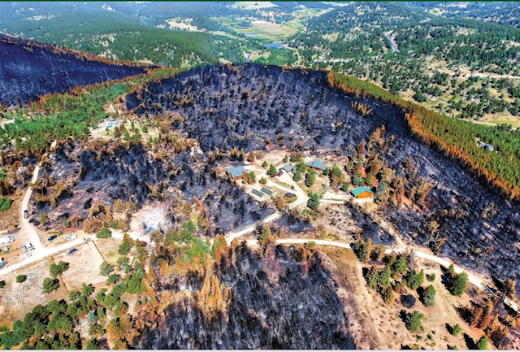
Why is fire safety important?
Changing climate trends, 100 years of fire suppression and new construction means there is a greater likelihood of wildfire near structures
Fire safety practices work!
Increase chances of your home surviving a fire
Protect your families, friends and community
Protect your investment!
Insurance companies have been declining policies
Community-wide fire risk reduction practices can impact ISO ratings for insurance
Tollgate and North Summit ISO rating is currently 10/10 (bad)
Forest Conservation: Fire used to clear forests, now we must we must do it to have healthy forests & happy wildlife
Notes:
https://www.isomitigation.com/ppc/fsrs/ - Factors that affect ISO ratings

Slide 3
2022 Accomplishments
Evacuation Plan
Collaborated with Kathryn McMullin (County Emergency Manager) to create an Evacuation Plan specific to Tollgate.
Increased community knowledge of the stagecoach evacuation route, the Tollgate specific emergency alert system, and how to be prepared.
Distributed to residents via a local HOA website, over social media, through emails
Distributed to county officials including the sheriff, county emergency manager, and Chief Ben Nielson.
CERT Team
- A team of Tollgate residents are in the process of becoming CERT (Community Emergency Response Team) certified
- Online trainings and hands-on training with the county Emergency Manager happen on a scheduled basis.
Clean Up Days
Three days (one each in June, July and August) were spent by volunteers removing flammable materials along roads and properties
Wildland Fire professionals were consulted with to selected strategic locations to increase successful firefighting efforts
A total of 106 volunteers put in a total of 579 hours on these days
Community members and local businesses donated raffle items and money for food
Fire Safety and Awareness Day
Presentations about Tollgate’s emergency evacuation procedures, creating defensible space around homes and other topics
Distributed Tollgate specific evacuation plans, emergency phone numbers, and encouraged residents to become involved in fuel mitigation.
Residents heard from and connected with a variety of county officials and professionals.
Signage
- A group of volunteers started the process of developing an efficient sign strategy
- Future plans include purchasing and hanging emergency evacuation signs.

Slide 4
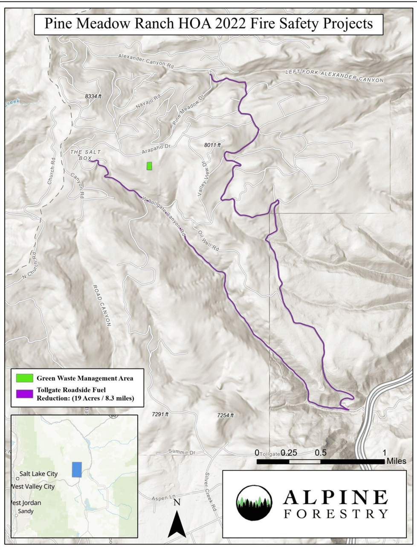
2022 Fuel Reduction Work
Professional Fire Mitigation Work
After an RFP process, Alpine Forestry was hired and completed fuels reduction work along the major evacuation corridors,Tollgate Canyon Road and Forest Meadows Road, totaling 8 miles.
Safer evacuation out for Tollgate Canyon Community
Safer egress/ingress for firefighters, emergency responders or utility workers.
What exactly was done?
Fuel mitigation and tree work done 10ft on either side of the roads.
Recommended amount of space to be cleared along roadsides is 20ft on either side.

Slide 5
2022 Budget Recap
2022 Fire Budget and Projects
Funding Source | Budget | Cost
HOA Fire Budget 2022 | $ 15,000
2022 Special Assessment | $ 45,336
Donations | $ 6,000
 | $ 66,336
Projects
Mitigation |  | $ 56,400
Burn Pile Management |  | $ 6,000
Burn Pile Stacking |  | $ 5,000 | Estimated
 |  | $ 67,400
Summary
Mitigation - $56,400
Burn Pile Management - $6,000
Stacking - Pending
Includes $6,000 in Donations

Slide 6
2023 Budget Priorities
Budget Request
- Currently, Fire Safety Committee (FSC) receives $15,000 from general budget
- Approximately $70/lot increase for FSC: $56,000 budget
2023 Budget priorities
Out of remaining 27 HOA miles of roads, 7 would receive shaded fuel break work.
Cost estimate $8,500/mile. I.e. 7 miles= $60,000
Burn pile management (re-stack & burning), 2022 estimate $10,000
Signage, 2022 estimate $1,000
Additional funds & donations will be used to work through future goals and continue the fire safety and education needs of the community
Total Proposed 2023 Budget: $71,000

Slide 7
Multiply our Money with Federal Grants
With an annual budget for fire and safety we are able to apply and receive federal grants to increase our available funds by 300-500%
Grant Funding Matching?
- Recipients (HOA) must typically match 25% of funds approved
- Consist of general budget and volunteer hours ($28.50 per volunteer hour)
Applied For
FEMA Grant-
Applied in March 2022
Potential for up to $240k
HOA to match $78k over 3 yrs
Opportunities
Community Wildfire Defense Grant-
Through US Forest Service
Up to $10M per applicant(25% Match)
Turn our $71,000 into $284,000 each year for 5 years
Many More opportunities available!
What can we use grant funds for?
Education
Mitigation
Equipment
Professional work
Long term plans & physical labor
Administrative costs
Much More!
Notes:
CWDG Information/Criteria: https://drive.google.com/drive/u/2/folders/1oV01TG_Zh8jUGRSdLSOJWevNOJcrEb6x

Slide 8
Working Towards a Safer Community
Continued Road Fuel Mitigation Work (Volunteered and Paid)
Provide safety corroders for evacuation & fuel breaks to slow fires.
Emergency Exit & Safety Zone Signage
Reduce confusion and increase safety during an evacuation or emergency
Burn Pile Management
Provide an easy & inexpensive avenue for home owners to remove fuel material
Pond Dredging
Reduce refill time for helicopters & fire fighting equipment
Safety Zone Improvements
Improve safe spaces during emergency and improve helicopter evacuation capabilities
Local Official Partnerships & Education
Continued volunteer days and education events to help prepare our community

Slide 9
WHY VOTE YES?
Fire Safety Committee is dedicated to encouraging and supporting fire safety of the Tollgate Community through mitigation and education with:
Guidance from Professional Organizations and Experts
National Firewise Fire Mitigation Framework
County Emergency Manager Kathryn McMullin
County Fire Warden Bryce Boyer
Regional Wildland Urban Interface Specialist Travis Wright
Wildland Fire, Emergency Response, Resource Management Professionals at Alpine Forestry
Proven Track Record of Accomplishment and Fiscal Responsibility
A consistent budget provides year over year improvement opportunity
Money spent on direct fire mitigation and community safety
Thank you to everyone who has worked hard to help make Tollgate a safer community!

